Slide 1


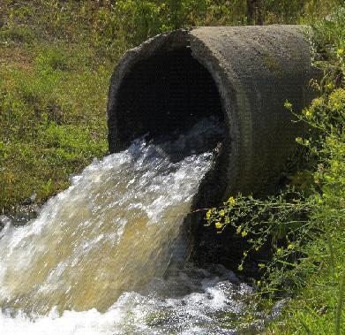
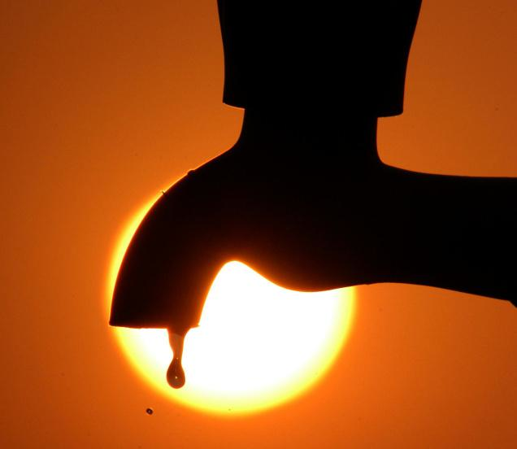
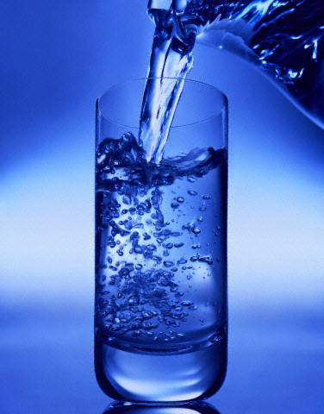
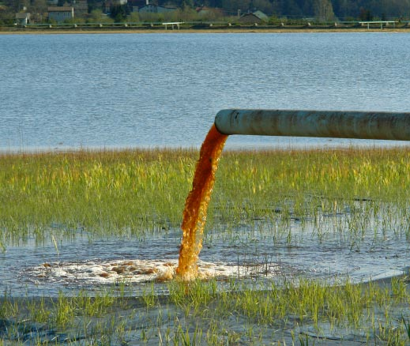
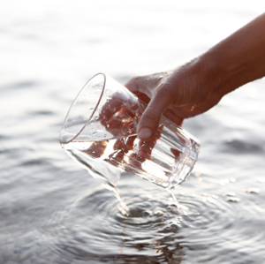
FUNDAMENTALS OF WATER AND WASTEWATER TREATMENT
Summer 2020

Slide 2
Why do we treat water?
To prevent the transmission of diseases and consumption of chemically-unsafe water
https://www.epa.gov/ground-water-and-drinking-water/national-primary-drinking-water-regulations
Aesthetically appealing
Non-corrosive and non-scaling to infrastructure

Slide 3
Why do we treat wastewater?
To prevent the transmission of diseases
To protect receiving environments
and downstream users (water rights…)
To enable water reuse
Non-potable reuse
Indirect potable reuse
Direct potable reuse

Slide 4
History of Water Treatment and Regulations
Ancient civilizations established around water sources – quantity and quality
Water treatment originally focused on improving aesthetic qualities of water
During the mid to late 1800s, scientists gained a greater understanding of sources and effects of drinking water contaminants, especially those that were not visible to naked eye
In 1908, chlorine was used for the first time as a primary disinfectant of drinking water in Jersey City, New Jersey
In 1914, the U.S. Public Health Service sets standards for the bacteriological quality of drinking water
Safe Drinking Water Act of 1974 – MCLs
Regulations stem from bad past experiences and from research

Slide 5
Challenges in Water Treatment
Water analysis – quantity and quality…
How clean is clean?
Each source is different and requires different approach
The quality (and capacity) of source water can change seasonally or gradually – how do we plan ahead?
Response to demand
Alternative resources / reuse / desalination

Slide 6
Sources of Water that Require Treatment
Surface (rivers, lakes, reservoirs)
Groundwater (fresh, brackish, under-the-influence)
Seawater
Domestic wastewater
Industrial wastewater

Slide 7
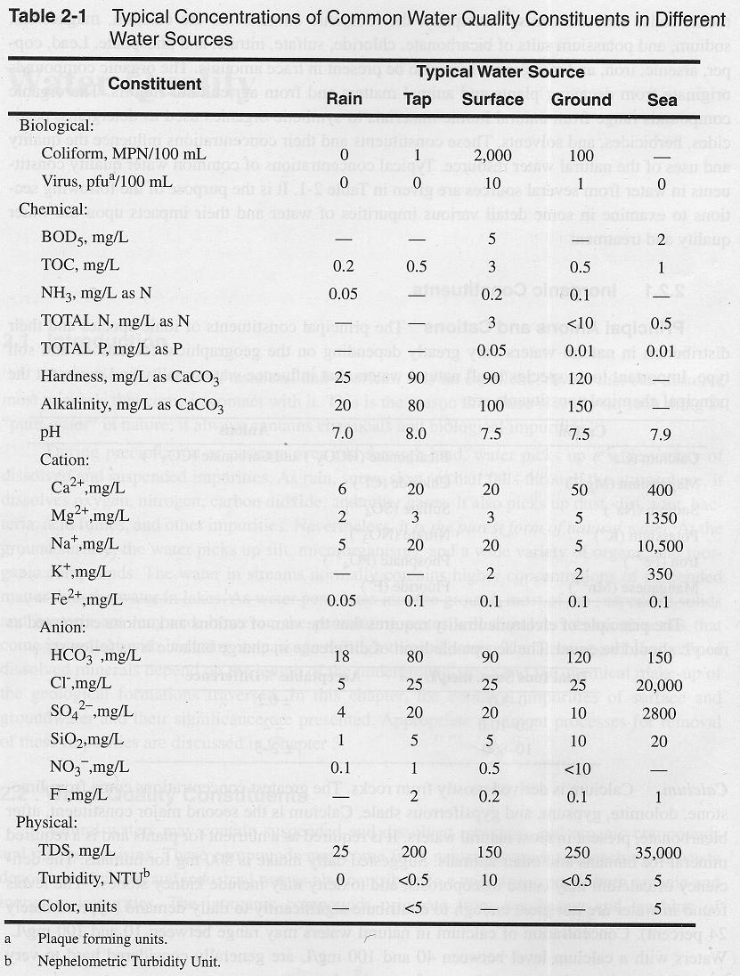
Typical concentrations of common water constituents in different water sources

Slide 8
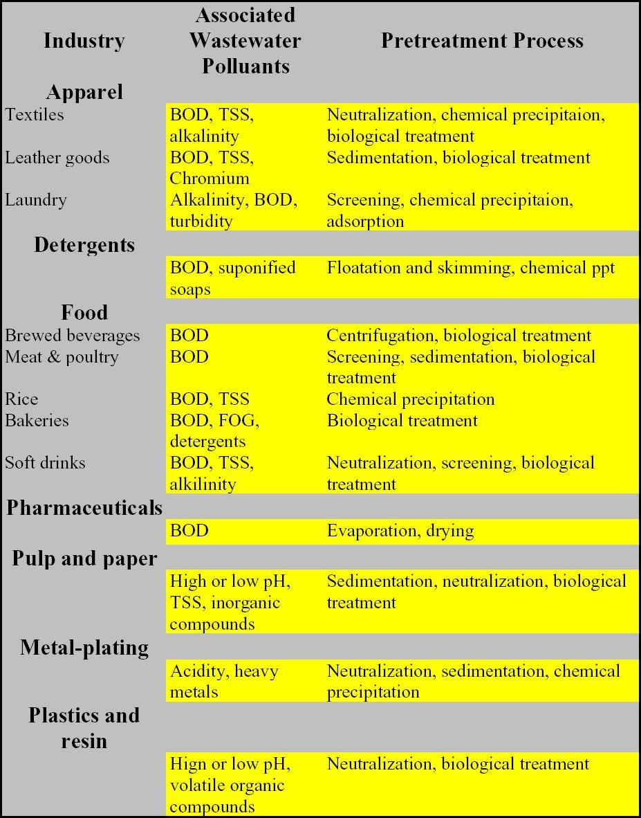
Industrial Wastewater

Slide 9
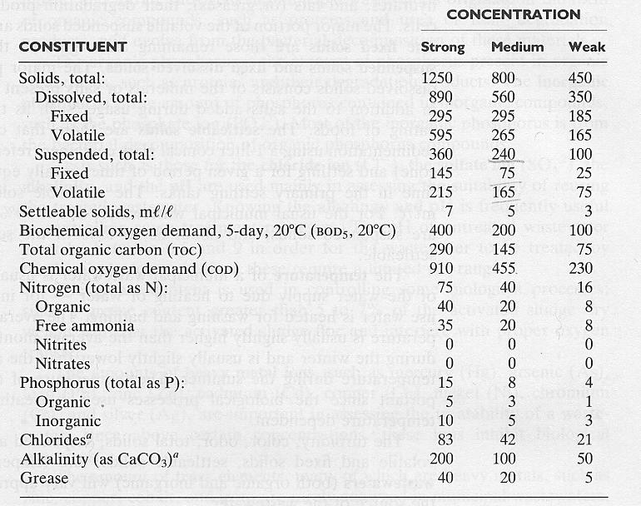
Typical Characteristics of Untreated Municipal WW in the US

Slide 10
Possible Levels of Pathogens in WW
Type of pathogen |  | Possible concentration per liter in municipal wastewater¹
Viruses: | Enteroviruses² | 5,000
Bacteria: | Pathogenic E. coli³ | Uncertain?
 | Salmonella spp. | 7,000
 | Shigella spp. | 7,000
 | Vibrio cholerae | 1,000
Protozoa: | Entamoeba histolytica | 4,500
Helminths: | Ascaris Lumbricoides | 600
 | Hookworms⁴ | 32
 | Schistosoma mansoni | 1
 | Taenia saginata | 10
 | Trichuris trichiura | 120
¹ Based on 100 LPCD of municipal sewage and 90% inactivation of excreted pathogens ² Includes polio-, echo- and coxsackieviruses ³ Includes enterotoxigenic, enteroinvasive and enteropathogenic E. coli ⁴ Anglostoma duedenale and Necator americanus
Source: Feachem et al. (1983)

Slide 11
Variation in Water Quality (example from surface water)

Slide 12
Mechanisms in Water and Wastewater Treatment
of
Dissolved chemical (organic/inorganic)
Colloids
Particles
Gases
Microorganisms
Removal
Addition
Transformations
Fate

Slide 13
Treatment Processes for Drinking Water Include:
Particulate removal:
Coagulation/Flocculation
Sedimentation
Flotation
Filtration
Membranes
Advanced processes:
Oxidation/Reduction
Precipitation
Ion exchange
RO membranes
Biological treatment
Softening
Adsorption
Pathogens removal:
Disinfection
Gas addition or removal:
Aeration
Stripping

Slide 14
Overlap with Wastewater Treatment Processes:
Particulate removal:
Coagulation/Flocculation
Sedimentation
Flotation
Filtration
Membranes
Advanced processes:
Oxidation/Reduction
Precipitation
Ion exchange
RO membranes
Biological treatment
Softening
Adsorption
Pathogens removal:
Disinfection
Gas addition or removal:
Aeration
Stripping

Slide 15
Projects this summer…
Particulate removal:
Coagulation/Flocculation
Sedimentation
Flotation
Filtration
Membranes
Advanced processes:
Oxidation/Reduction
Precipitation
Ion exchange
RO membranes
Biological treatment
Softening
Adsorption
Pathogens removal:
Disinfection
Gas addition or removal:
Aeration
Stripping

Slide 16
Water and Wastewater Treatment: Common Elements
Multiple unit processes and unit operations
Consideration of hydraulic and watershed issues
Skill overlap for professionals

Slide 17
Water and Wastewater Treatment: Differences
Different receptors – risk assessment
Different perspective on pollutants (e.g., organics) and concentrations
Different standards that govern design of facilities
Different legislation

Slide 18
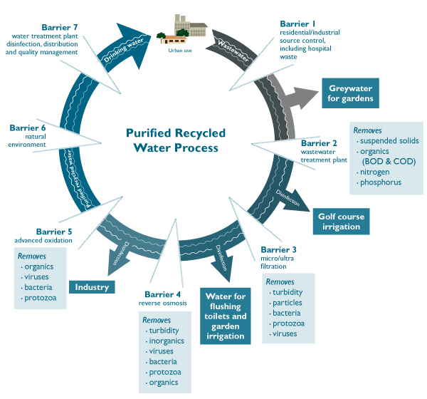

Slide 19
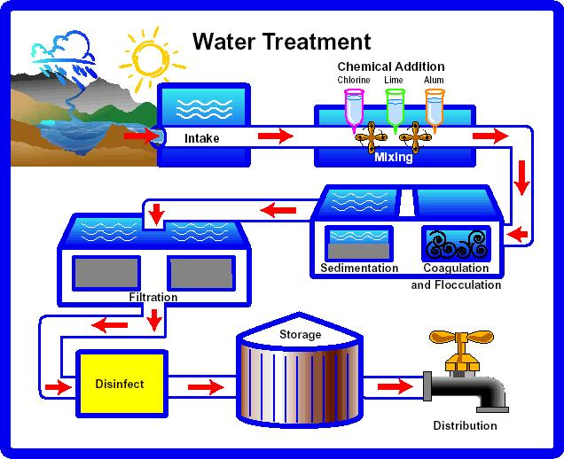
Conventional Water Treatment Train
https://www.youtube.com/watch?v=9z14l51ISwg

Slide 20
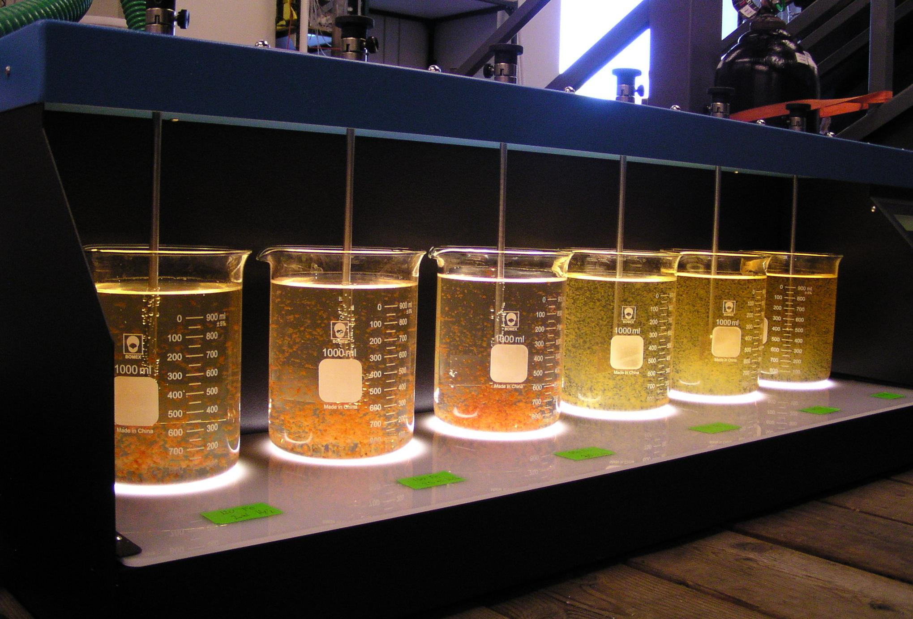
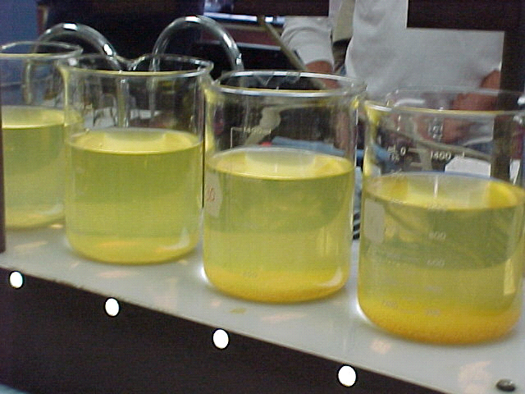
Coagulation

Slide 21
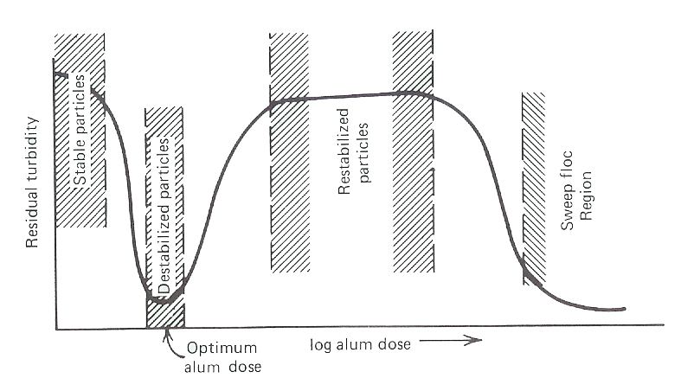
Destabilization and Restabilization

Slide 22
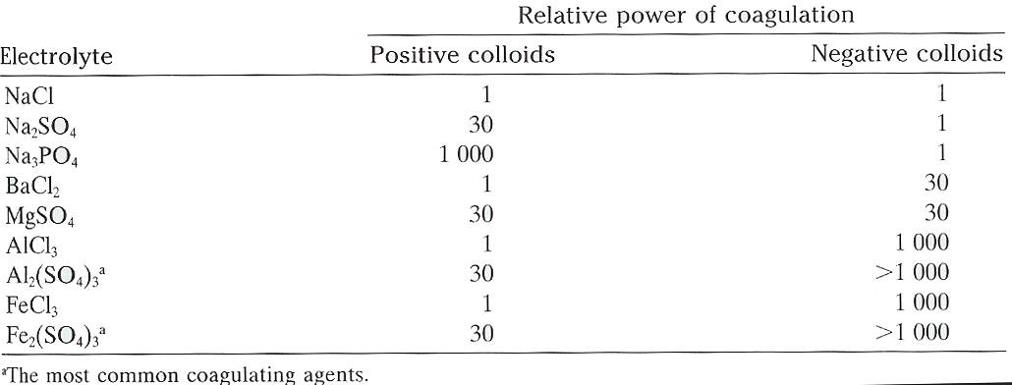
Coagulating Power of Inorganic Electrolytes

Slide 23
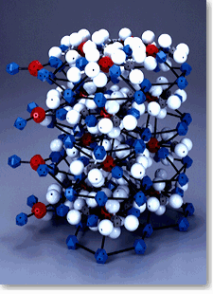
Coagulation in Wastewater Treatment
Used mainly for removal of phosphorus (phosphate)
Multivalent ions are used (Ca (from lime), Al, Fe)
10Ca²⁺ + 6PO₄³⁻ + 2OH⁻ ←→ Ca₁₀(PO₄)₆(OH)₂
Hydroxyapatite
Al³⁺ + H_{n}PO₄³⁻ ←→ AlPO₄ + nH⁺
Fe³⁺ + H_{n}PO₄³⁻ ←→ FePO₄ + nH⁺
Competition/coprecipitation

Slide 24
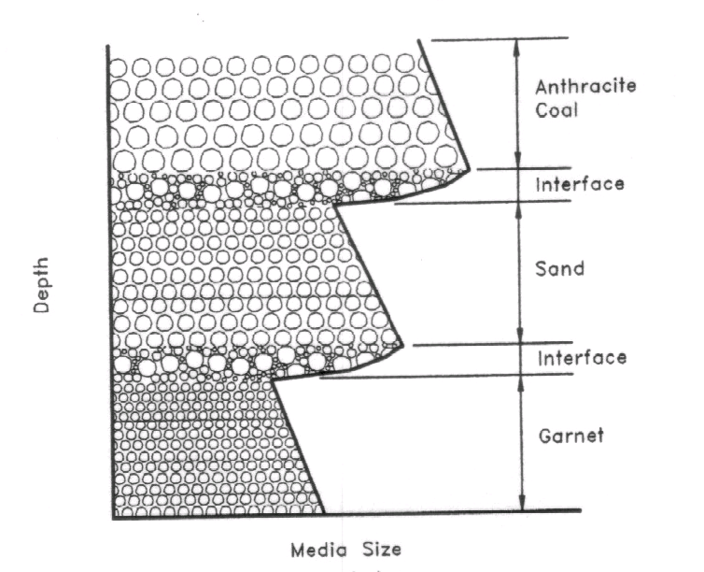
Mixed-Media Filter
anthracite coal (1.55), quartz sand (2.65), garnet (4.05)

Slide 25
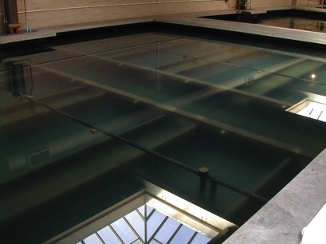
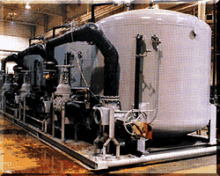
Filters Classified by Driving Force
Gravity filters:
2-3 m head
housed in open concrete or steel tanks
large and small systems
Pressure filters:
higher head
housed in closed steel vessels
costly; small systems

Slide 26
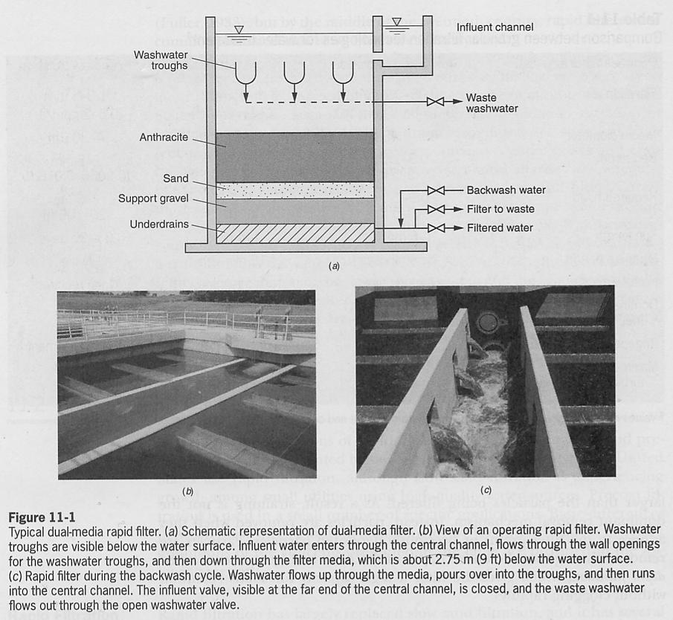

Slide 27
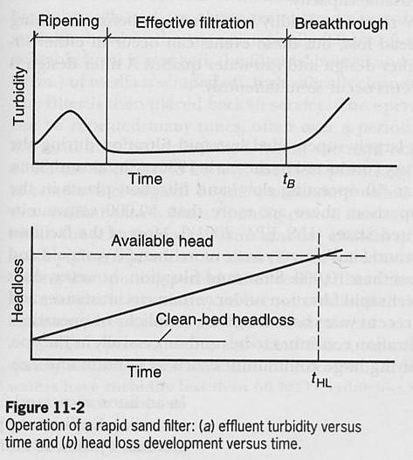
Rapid Filtration – Filter Run
Effluent turbidity characterized by three distinct segments:
Ripening
media conditioning (15 min - 2 hr)
Sometimes contain two peaks
Size and duration can be reduced by proper backwashing procedure
Filter-to-waste line
Effective filtration
Steady state with turbidity <0.1 NTU
Gradual increasing in head loss
Breakthrough
Filter bed can’t hold more particles
Effluent turbidity increases
Headloss increases

Slide 28
Rapid Filtration – End of Filter Run
Can be triggered by several events and lead to backwash:
Breakthrough
Preventing high-turbidity water from entering the distribution system
Headloss
Increases beyond the available head through the process
Rapid filters are typically designed with 1.8 - 3 m (6 - 10 ft) available head
If in specific cases neither are reached within several days: utility initiate backwash after a set period of time

Slide 29
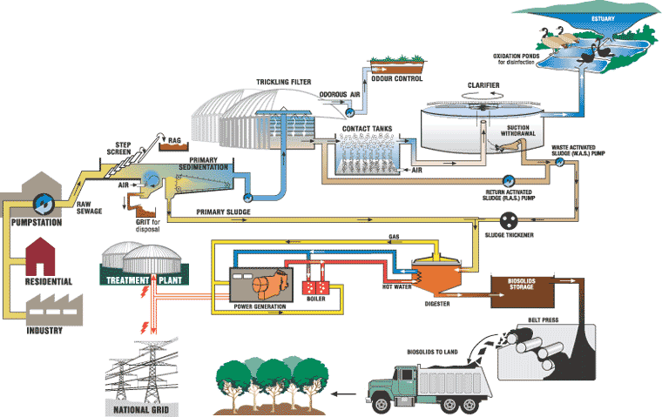
Conventional Wastewater Treatment Plant
http://www.youtube.com/watch?v=ZSFdOjxB-1I

Slide 30
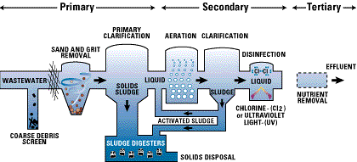
Types of Wastewater Treatment Plants
https://www.yakimawa.gov/services/wastewater-treatment-plant/operations-maintenance/
Primary Treatment Removal
25-50% of the incoming BOD₅
50-70% of the TSS
~65% of the oil and grease
Secondary Treatment Removal
Further treatment of primary
Removal of biodegradable dissolved and colloidal organic matter
High-rate biological treatment typically remove 85 % of the BOD₅ and TSS
Tertiary Treatment Removal
Specific constituents that cannot be removed by secondary treatment
Individual processes necessary to remove N, P, TSS, refractory organics, heavy metals, and dissolved solids

Slide 31
Types of Wastewater Treatment Plants
Primary Treatment
Removal of settleable organic and inorganic solids by sedimentation, and the removal of materials that will float (scum) by skimming
25 to 50% of the incoming biochemical oxygen demand (BOD₅), 50 to 70% of the total suspended solids (SS), and ~65% of the oil and grease are removed during primary treatment

Slide 32
Types of Wastewater Treatment Plants
Secondary Treatment
Further treatment of the effluent from primary treatment
Removal of biodegradable dissolved and colloidal organic matter using aerobic biological treatment processes
Treatment is performed in the presence of oxygen by aerobic microorganisms that metabolize organic matter in the wastewater → producing more microorganisms and inorganic end-products (CO₂, NH₃, and H₂O)
Activated sludge processes, trickling filters or biofilters, oxidation ditches, and rotating biological contactors (RBC)
High-rate biological treatment processes, in combination with primary sedimentation, typically remove 85 % of the BOD₅ and SS originally present in the raw WW and some of the heavy metals

Slide 33
Types of Wastewater Treatment Plants
Tertiary / Advanced Treatment
Employed when specific wastewater constituents that cannot be removed by secondary treatment must be removed
Individual treatment processes are necessary to remove nitrogen, phosphorus, additional suspended solids, refractory organics, heavy metals, and dissolved solids

Slide 34
Contaminant Removal Effectiveness
Process | Suspended solids | Dissolved organics | Dissolved inorganics | Micro-organisms | Dissolved gases
Biological Processes
Activated sludge | X | X | -- | X | --
Anaerobic digester | X | X | -- | -- | --
Bio-filters | -- | X | -- | -- | --
Extended aeration
Bio-denitrification | -- | L | -- | -- | --
Bio-nitrification | X | X | -- | -- | --
Oxidation ditch | X | X | -- | X | --

Slide 35
Contaminant Removal Effectiveness
Process | Suspended solids | Dissolved organics | Dissolved inorganics | Micro-organisms | Dissolved gases
Chemical Processes
Chemical oxidation
Catalytic oxidation | X | X | -- | X | X
Chlorination | X | X | -- | X | --
Ozonation | -- | L | -- | X | X
Wet oxidation | X | X | -- | X | X
Chemical precipitation | -- | -- | X | -- | --
Chemical reduction | -- | -- | X | -- | --
Coagulation
inorganic chemicals | X | X | -- | X | --
polyelectrolytes | X | X | -- | X | --
Disinfection | -- | -- | -- | X | --

Slide 36
Contaminant Removal Effectiveness
Process | Suspended solids | Dissolved organics | Dissolved inorganics | Micro-organisms | Dissolved gases
Chemical Processes
Electrolytic processes
Electrodialysis | -- | -- | X | -- | --
Electrolysis | -- | -- | X | -- | --
Extractions
Ion exchange | -- | -- | X | -- | --
Liquid-liquid (solvent) | -- | -- | X | -- | --
Incineration | X | X | -- | X | X

Slide 37
Contaminant Removal Effectiveness
Process | Suspended solids | Dissolved organics | Dissolved inorganics | Micro-organisms | Dissolved gases
Physical Processes
Carbon adsorption
Granular activated | X | X | -- | -- | X
Powdered | X | X | -- | X | X
Distillation | X | X | X | X | --
Filtration
Diatomaceous earth filtration | X | -- | -- | X | --
Dual media | X | -- | -- | X | --
Micro-screening | X | -- | -- | X | --
Sand filtration | X | -- | -- | X | --
Flocculation-sedimentation | X | -- | -- | X | --
Foam separation | X | -- | X | -- | --
Freezing | -- | X | X | -- | --

Slide 38
Contaminant Removal Effectiveness
Process | Suspended solids | Dissolved organics | Dissolved inorganics | Micro-organisms | Dissolved gases
Membrane processes
Microfiltration | X | -- | -- | X | --
Ultrafiltration | X | X | -- | X | --
Nanofiltration | X | X | X | X | --
Reverse osmosis | X | X | X | X | --
Stripping (air or steam) | X | X | -- | -- | X

Slide 39
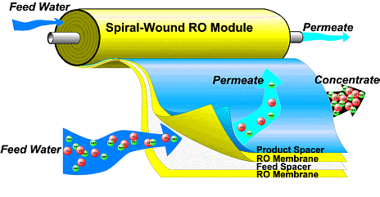
Membrane Separation
Membrane
Feed
Permeate
Particle or Solute Molecule
Solvent
Notes:
Membrane processes are used in water treatment for solid/liquid separation. RO and NF are pressure-driven membrane processes. In this figure, the orange circles represent the particles or solute molecules and the blue circles represents the solvent (water). The feed solution is forced under pressure through the membrane (animate) and the result is a relatively clean permeate solution.
Separation occurs because the membrane transports one component (the water) more readily than any other components.

Slide 40
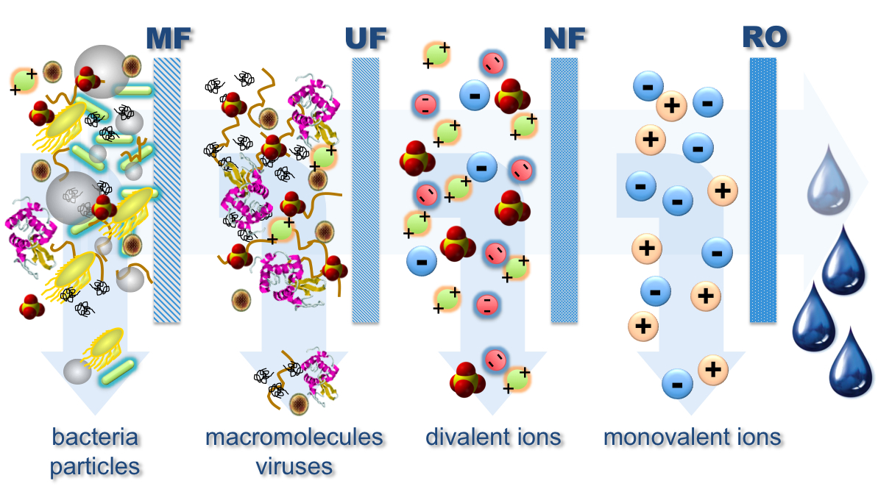
Pressure-driven Membrane Processes

Slide 41
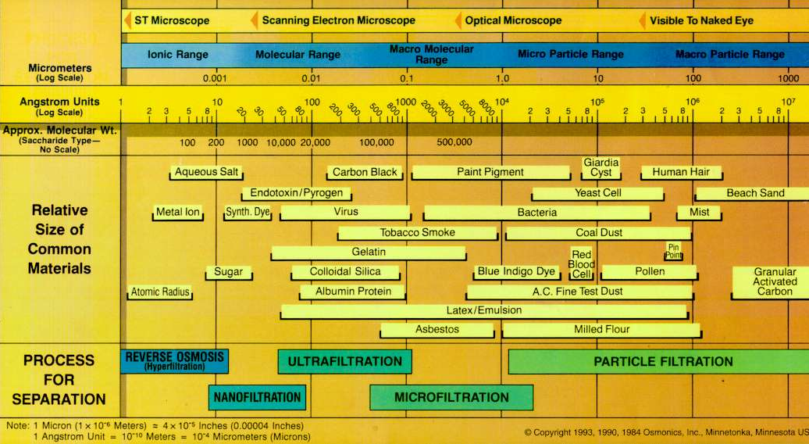
Selection of Membrane Processes
‘loose’ and ‘tight’

Slide 42
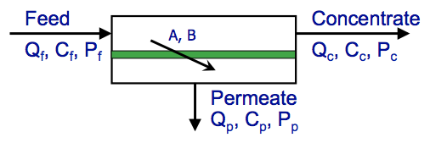
Material Balance in Membrane Separation
Mass balance for water flow
Q_{f} = Q_{c} + Q_{p}
Mass balance for solute flux
Q_{f}C_{f} = Q_{c}C_{c} + Q_{p}C_{p}
Product recovery
r = (Q_{p}/Q_{f})·100%
Solute rejection
rej = (C_{f}-C_{p})/C_{f} * 100%
= (1-C_{p}/C_{f}) * 100%
Power consumption:
Ė = Q_{f} * P_{f} (W)
SE = Ė/Q_{p} (kWh/m³)

Slide 44
Pathogen Reduction Goals vs. Credits for Direct Potable Reuse
GOALS
Virus
Giardia
Crypto
12-log
10-log
10-log
OZONE
BAF
UF
GAC
UV
Cl₂
 | Ozone | BAF | UF | GAC | UV | Cl₂ | Total
Virus | 5-log | -- | -- | -- | 6-log | 2-log | 13-log
Giardia | 2.5-log | -- | 4-log | -- | 6-log | -- | 12.5-log
Cryptosporidium | -- | -- | 4-log | -- | 6-log | -- | 10-log

Slide 45
Alternative Treatment Trains (The subject of the new CEEN 471)

Slide 46
So…, where the data is coming from…?
Online continuous measurements:
Flow, pressure, level, temperature, conductivity, pH, turbidity (including TSS), ORP, oxygen (DO), TOC, specific ions (ammonia, nitrate, chlorine, hardness, etc.), state
Sensor vs. analyzer!
Lab analysis
Metals (ICP), anions (IC), radionuclides, organic micropollutants (LC, GC), VOCs, O&G, microbial community, surface charge & morphology,

Slide 47
Thank you
~~~~~~~~~~~~~~~~~~~~~~~~~~~~~~~~~~~~~~~~~~~~~~~~
Tzahi Cath, Ph.D.
Professor and AQWATEC Director
COLORADO SCHOOL OF MINES
Department of Civil and Environmental Engineering
1500 Illinois St., Golden, Colorado 80401-1887
Office: 303.273.3402
Email: tcath@mines.edu
Cath URL: http://inside.mines.edu/~tcath/
AQWATEC URL: http://aqwatec.mines.edu/
ERC URL: http://urbanwatererc.org/
CEE URL: http://cee.mines.edu/
~~~~~~~~~~~~~~~~~~~~~~~~~~~~~~~~~~~~~~~~~~~~~~~~

